Slide 1
Reproducing Performance - The Good, the Bad, and the Ugly with contributions by the whole SPCL team and collaborators Keynote at Practical Reproducibility in HPC meeting in conjunction with SC24, Atlanta, GA, November 2024
T. Hoefler
Notes:
Abstract: Containers and Jupyter notebooks are useful tools for reproducing computational results of any packaged application. However, if the execution performance or efficiency is the science result, matters are more complex. It may not be sufficient to package codes in containers. In fact, containers may disturb the performance results and reproducibility. We outline a set of techniques to facilitate performance reproducibility in various settings. Some performance results may be linked to specific computer architectures or even specific system configurations that may not be accessible to other researchers or even the original team after a software update. We outline techniques to help researchers interpret results on the original system even if it is practically impossible to reproduce the original results. We discuss such techniques both in the context of pure performance but also in the context of the emerging field of data science and artificial intelligence that often allows for a performance-accuracy tradeoff. All-in-all, our work provides a set of guidelines to follow to support reproducible science of performance and benchmarking.

Slide 2
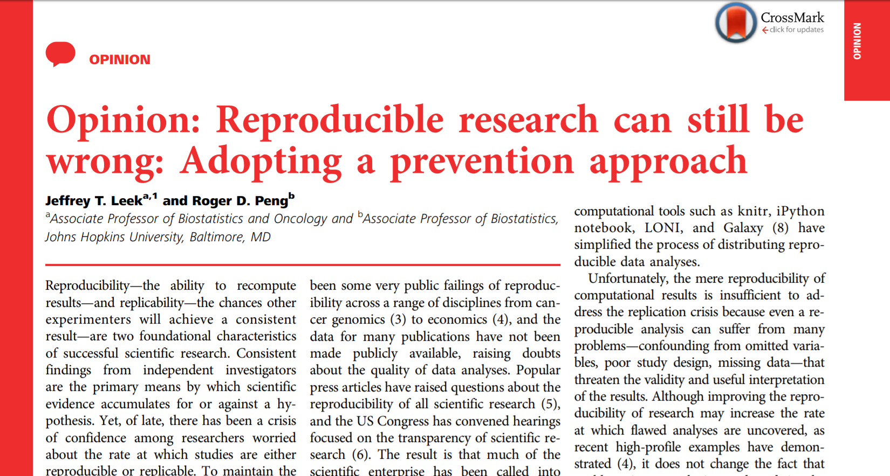

Terminology
PNAS, Feb. 2015
Reproducibility – identical results/conclusions with identical data and method
Replicability – non-identical but similar results/conclusions with similar data and method
“In the good old days physicists repeated each other’s experiments, just to be sure. Today they stick to FORTRAN, so that they can share each other’s programs, bugs included.” – Edsger Dijkstra (1930-2002), Dutch computer scientist, Turing Award 1972

Slide 3
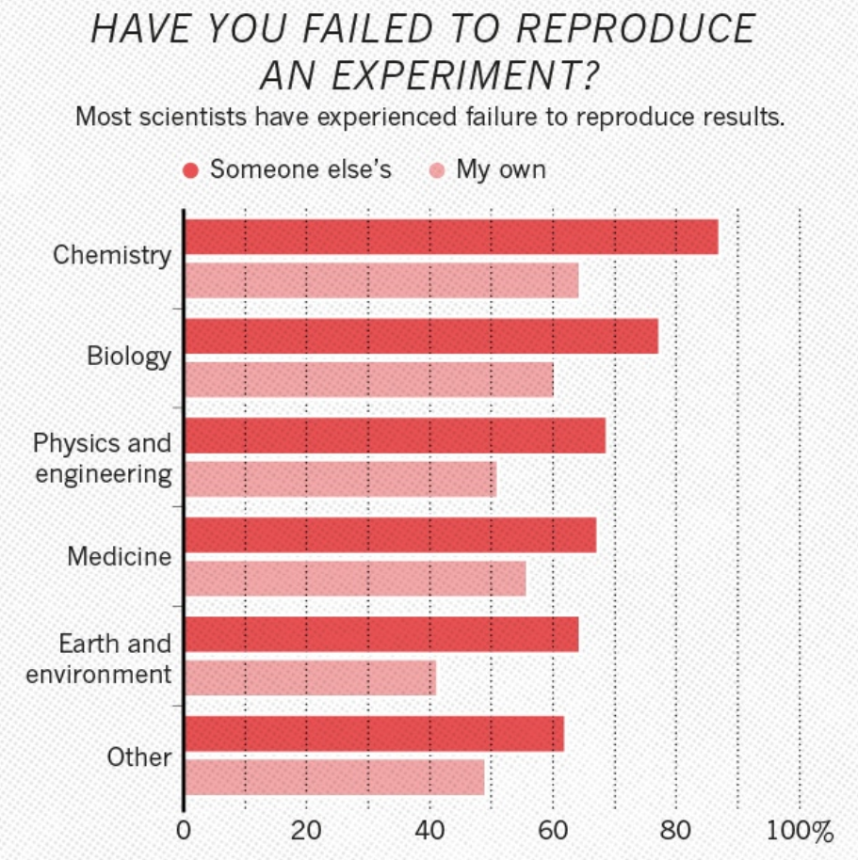
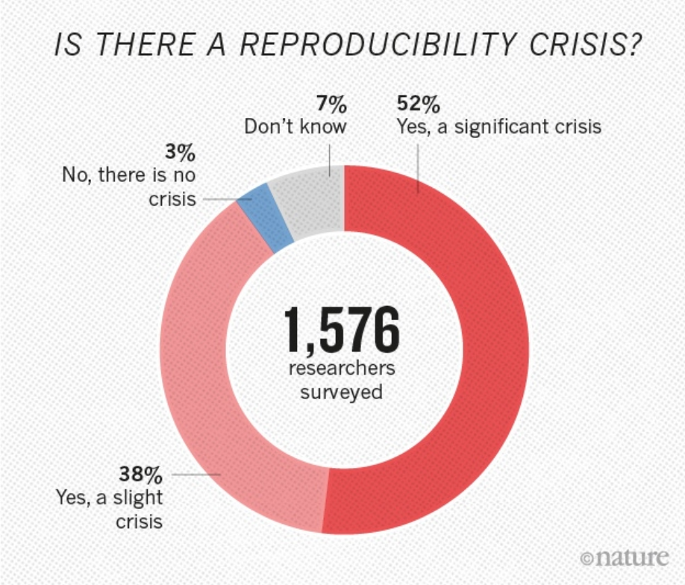
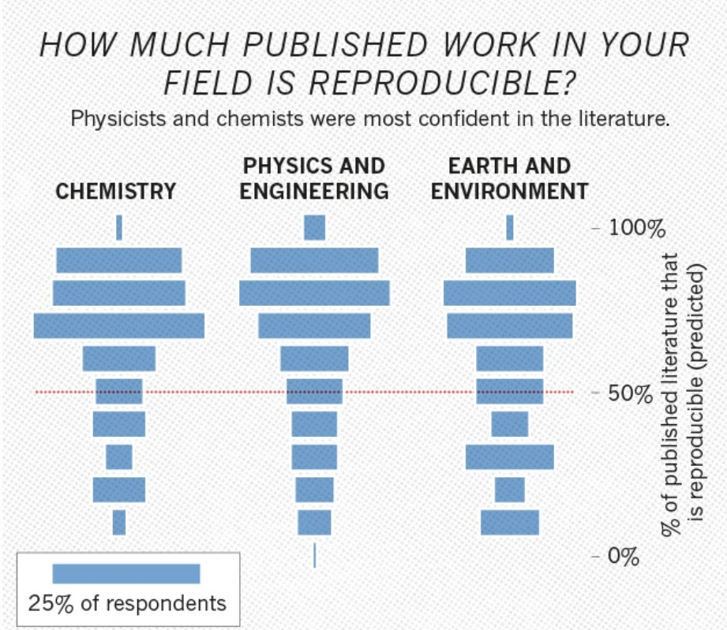
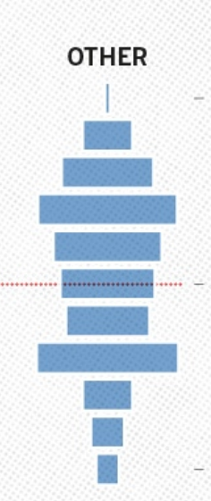

Reproducibility and replicability?
Nature, May 2016
Reproducibility – get the exact results
Replicability – repeat the effect/insight
includes CS/HPC ☺

Slide 4

The Good
Let us be
proud
of our achievements!

Slide 5


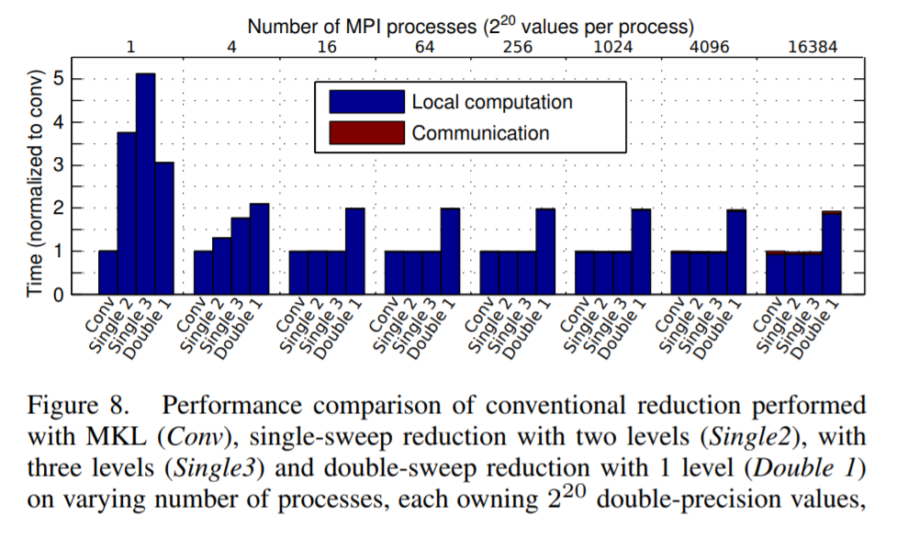
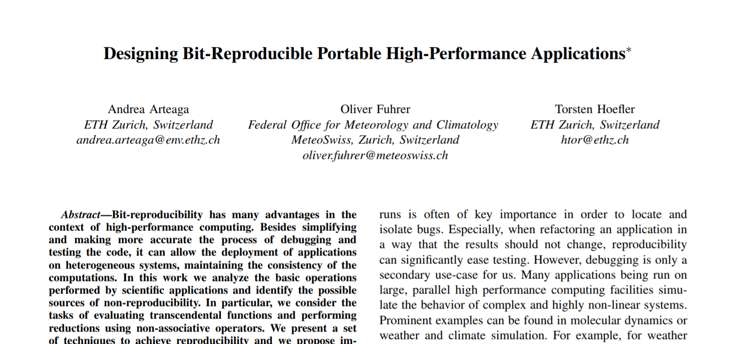
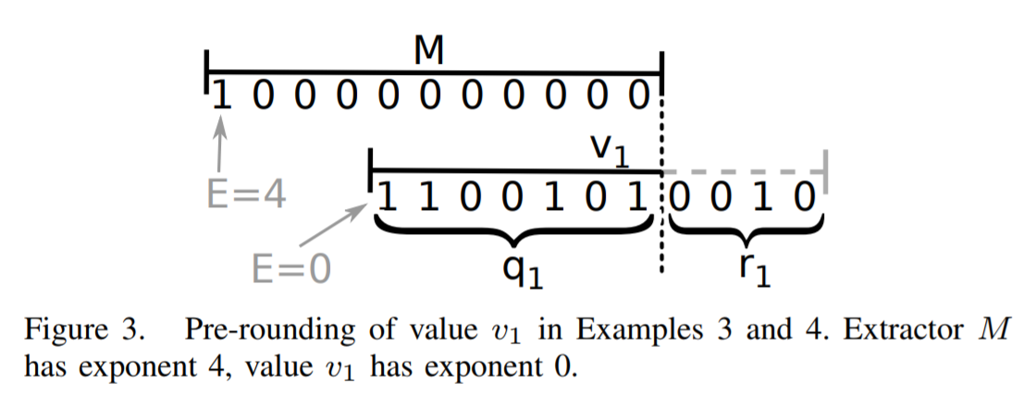
Functional reproducibility is relatively simple – release the code!
Single-threaded, if you don’t care much about performance
Gets a bit more complex when you share parallel codes (IEEE 754 is not associative)
IPDPS’14
Rump, JSC’09, Demmel, Nguyen, ARITH’13

Slide 6




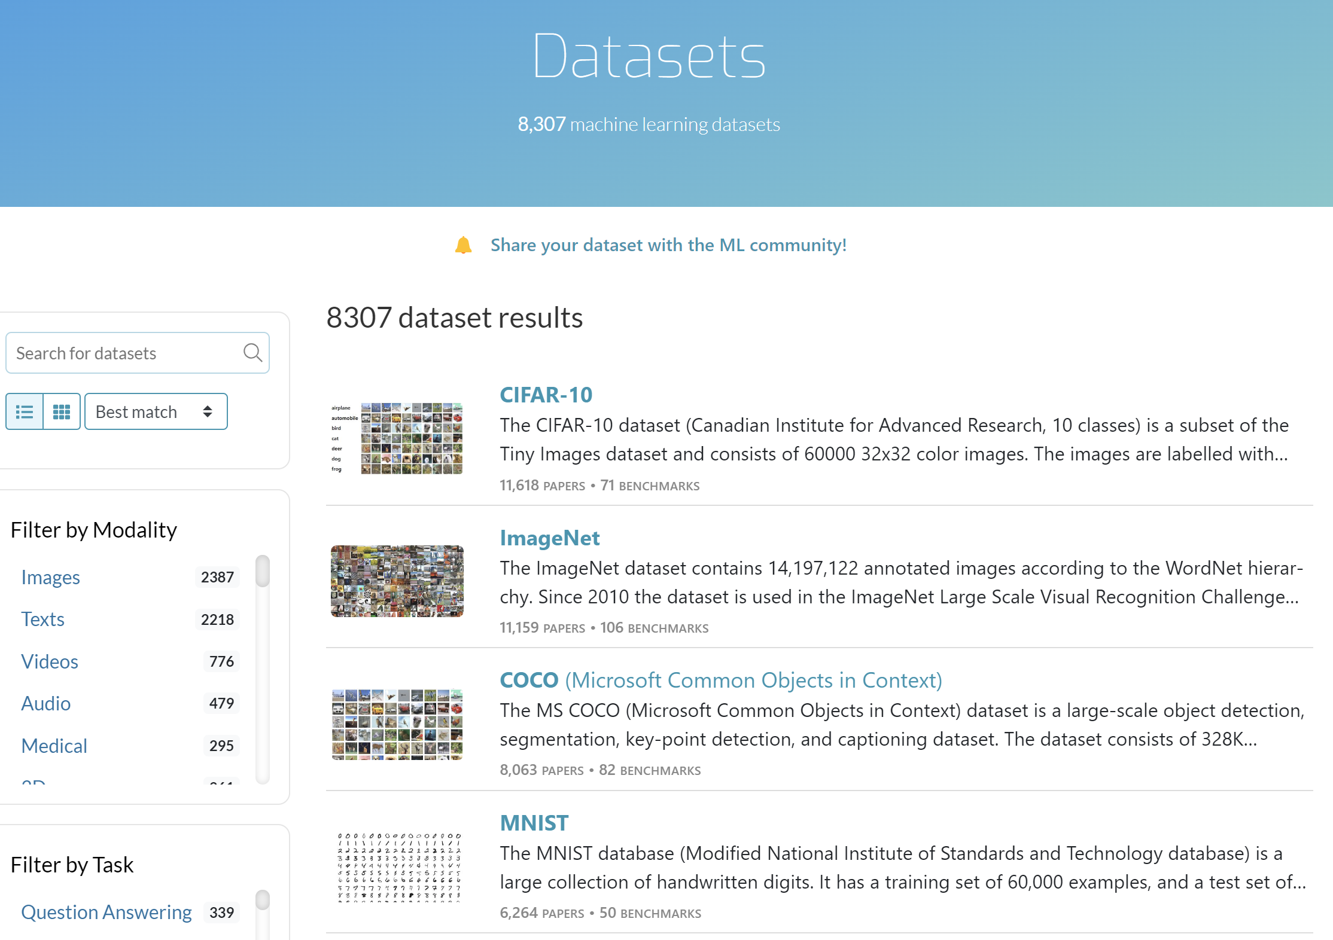
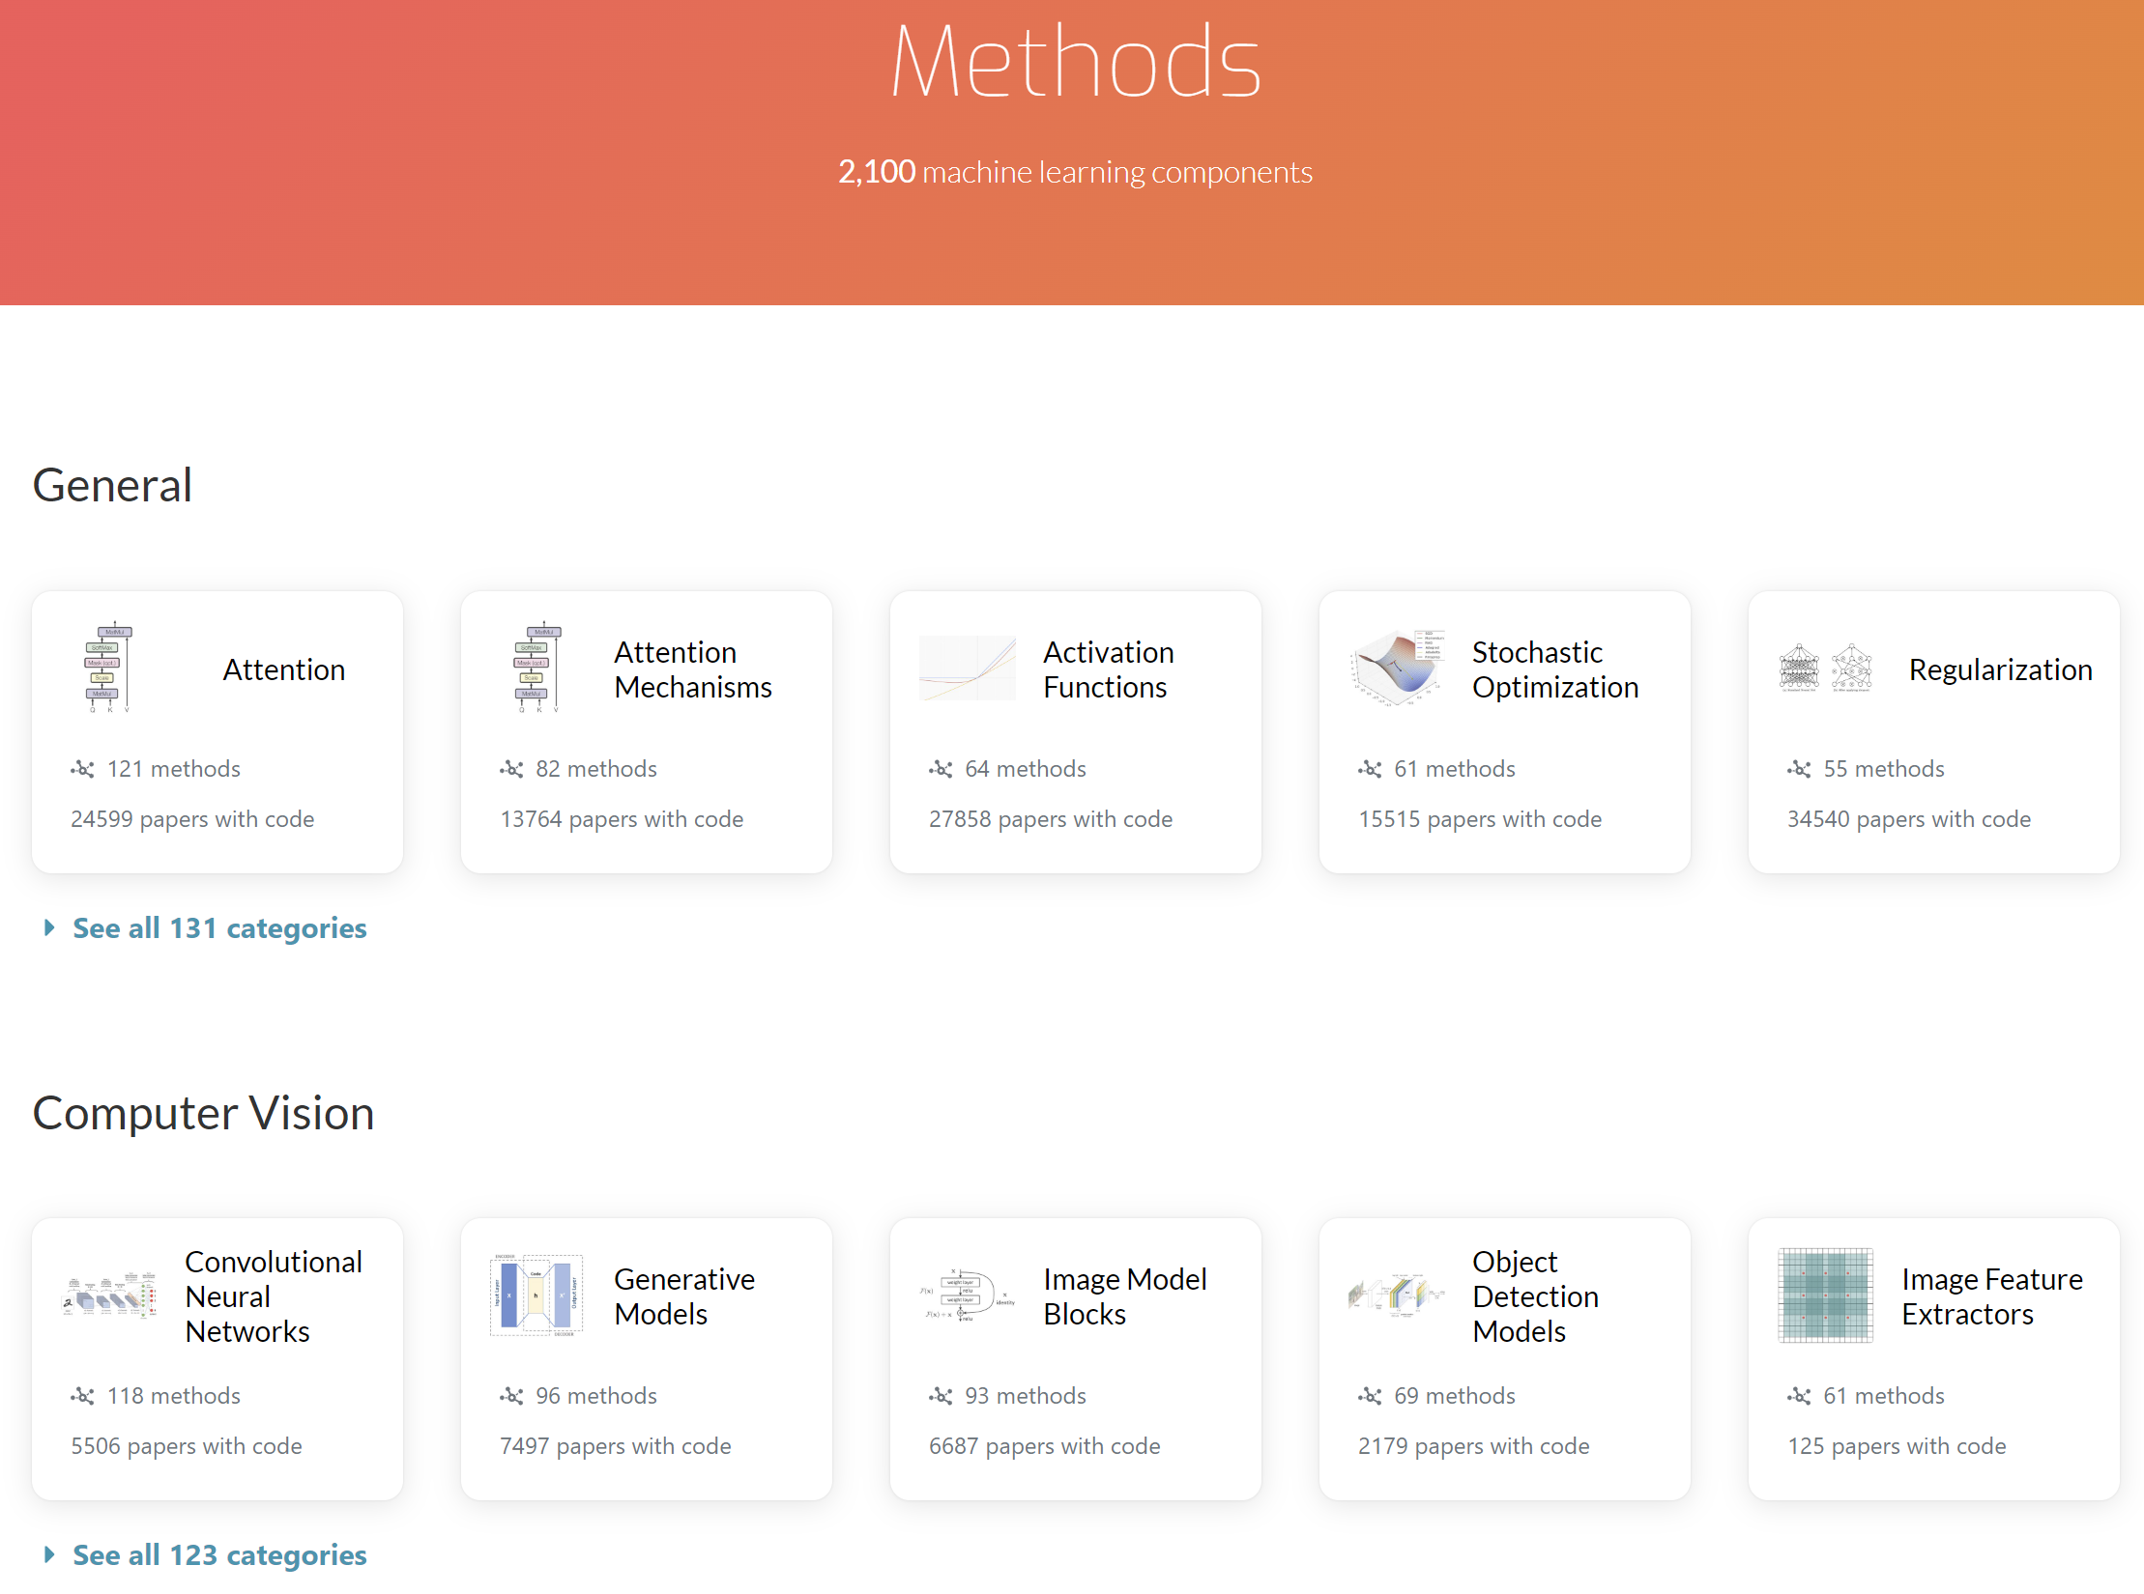

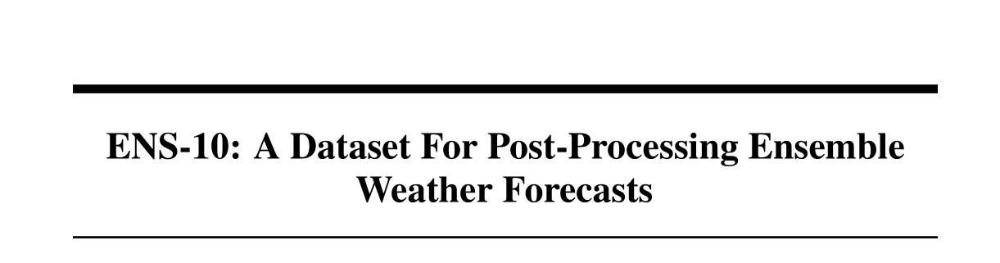
Example 1: Machine Learning
Significant community efforts for reproducibility, e.g.,
NeurIPS Reproducibility Program 2019
Code submission, repro challenge, repro checklist
paperswithcode.com
ML repro challenge
Kaggle (supports ML Repro Challenge - $500k GCP credits for awards)
Most ML research papers are reproducible!
Community even quickly replicates, e.g., huggingface
Reproducible papers have higher impact (folklore)
Datasets and Benchmarks help
performance benchmarks
Reproducibility Fosters Open-Source and Rapid Scientific Progress
scripts
data
network
paperswithcode.com/datasets
paperswithcode.com/methods
https://www.together.xyz/blog/redpajama
“RedPajama, a project to create leading
open-source models, starts by reproducing
LLaMA training dataset of over 1.2 trillion tokens”
NeurIPS’22 Dataset Track

Slide 7

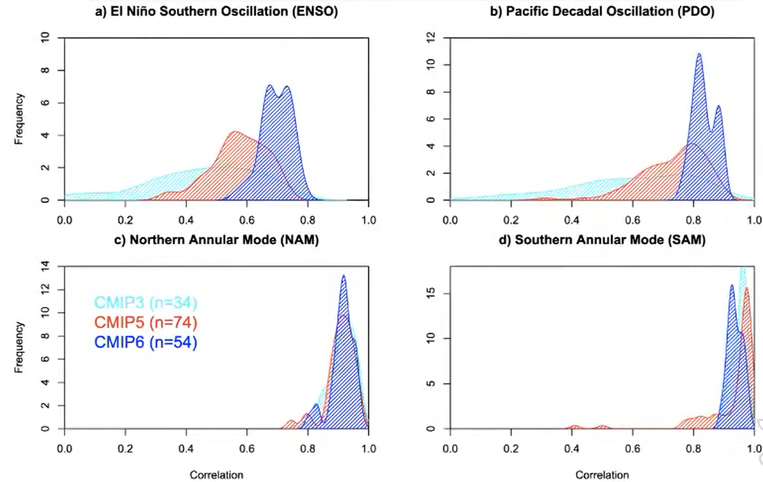
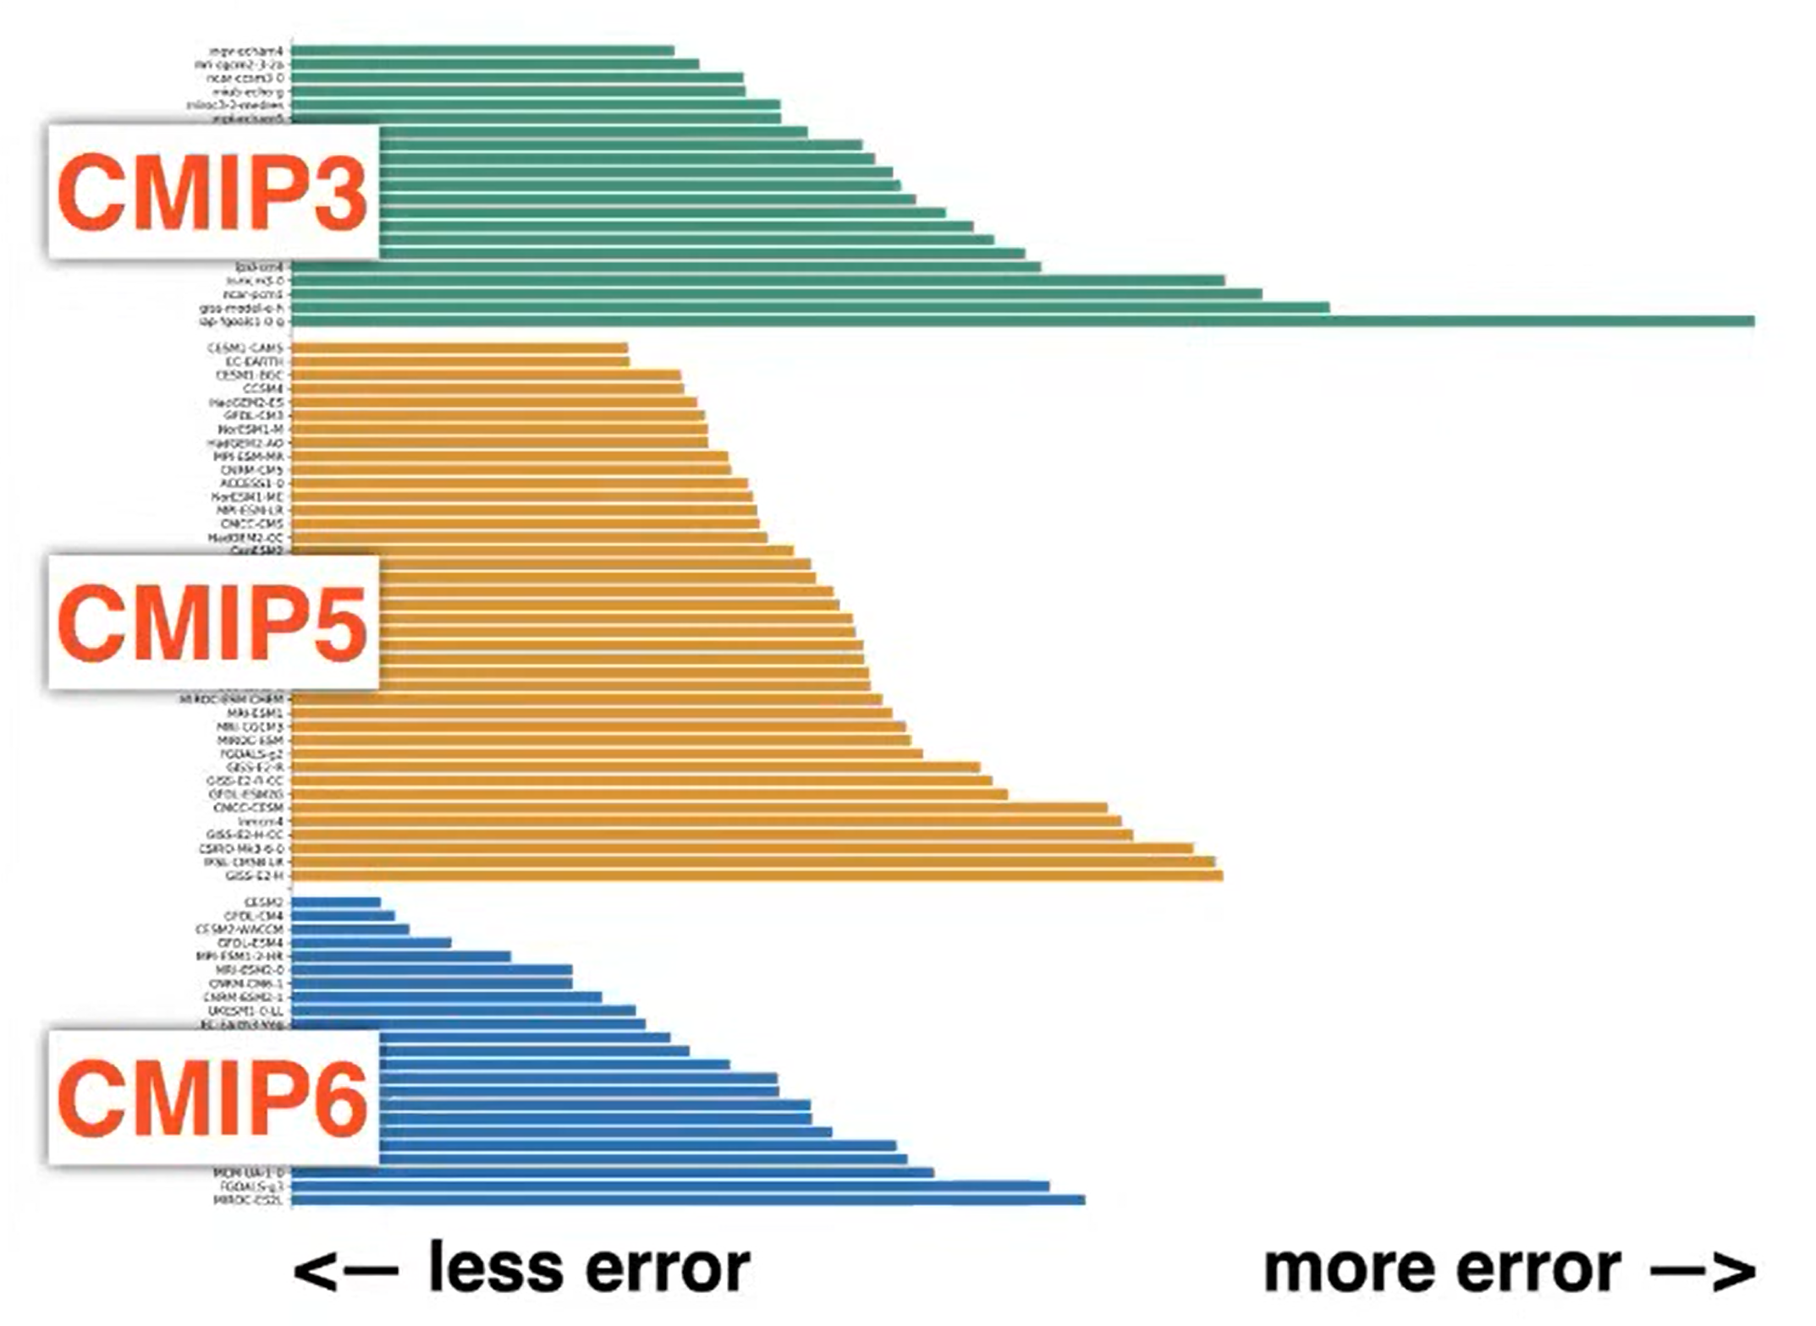
Example 2: Climate Modeling
WCRP Coupled Model Intercomparison Project (CMIP)
Compare (replicated) results among different climate models!
Shows even improvement over time
Very nice driver of scientific progress!
perfect prediction →
2007
2011
time
2016
Lukas Brunner (ETH)
Orbe et al. (2020)
Notes:
Right plot shows error for some arbitrary metric across various
Left plot shows a skill score – 1 is perfect prediction, 0 is no prediction

Slide 8
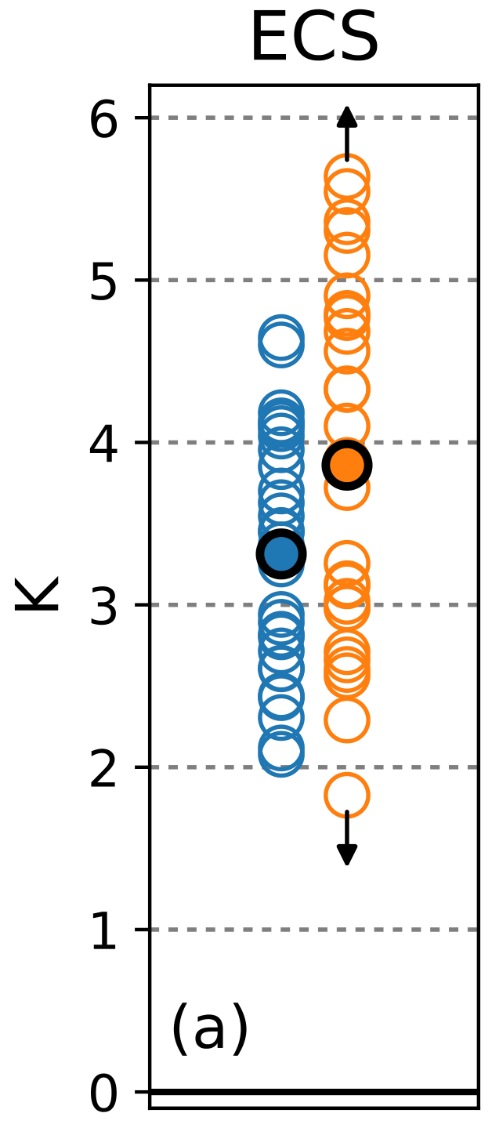



Example 2: Climate Modeling
WCRP Coupled Model Intercomparison Project (CMIP)
Compare (replicated) results among different climate models!
Yet, important metrics diverge!
CMIP5
(2011)
CMIP6
(2016)
Replicability Drives Major Scientific Directions!
How warm does it get if we double CO₂ in the atmosphere?
https://eve4climate.org/
Zelinka et al. GRL’20
Notes:
Right plot shows error for some arbitrary metric across various
Left plot shows a skill score – 1 is perfect prediction, 0 is no prediction

Slide 9

The Bad
Was the talk title not
“Reproducing Performance”?
That is unfortunately
not that easy!

Slide 10
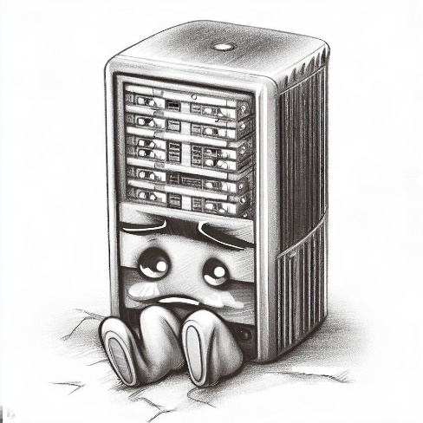
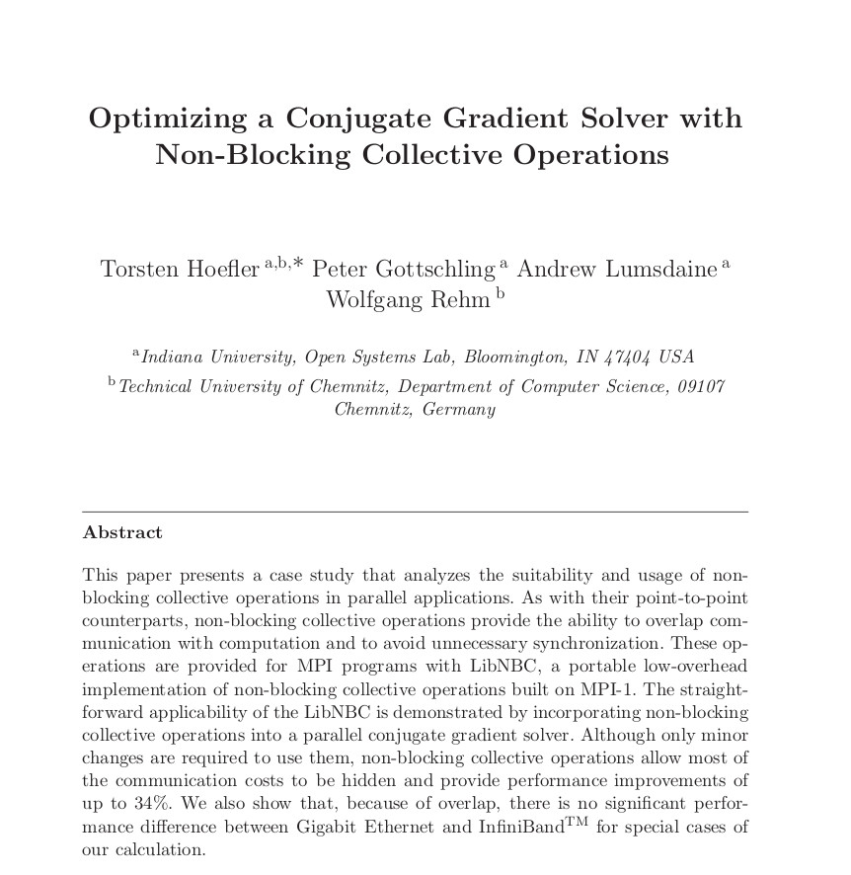
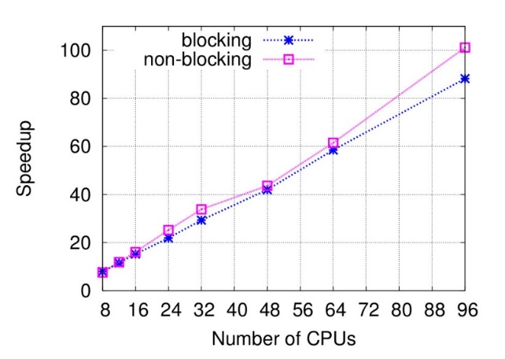
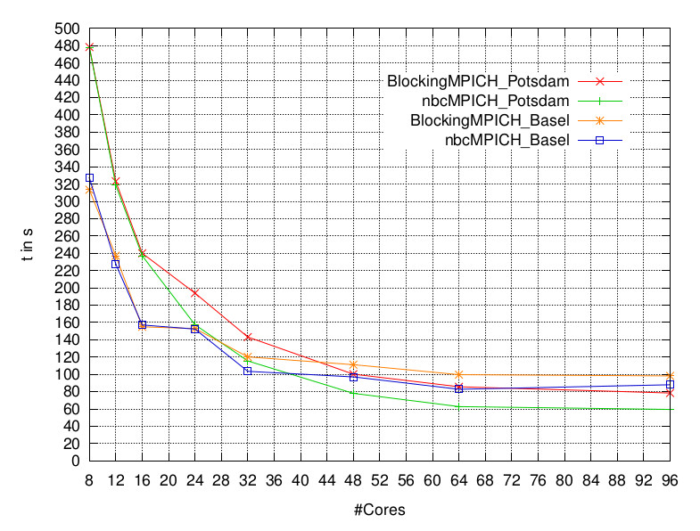
What if performance is your science result?
(2006)
Original findings:
If carefully tuned, NBC speed up a 3D solver
Full code published
800³ domain – 4 GB (distributed) array
1 process per node, 8-96 nodes
Opteron 246 (old even in 2006, retired now)
Super-linear speedup for 96 nodes
~5% better than linear
9 years later: attempt to reproduce ☺!
System A: 28 quad-core nodes, Xeon E5520
System B: 4 nodes, dual Opteron 6274
“Neither the experiment in A nor the one in B could reproduce the results presented in the original paper, where the usage of the NBC library resulted in a performance gain for practically all node counts, reaching a superlinear speedup for 96 cores (explained as being due to cache effects in the inner part of the matrix vector product).”
Reproducing performance results is hard! Is it even possible?
Moore’s law predicts ~100x speedups!
A
1 node
(system B)
B

Slide 11
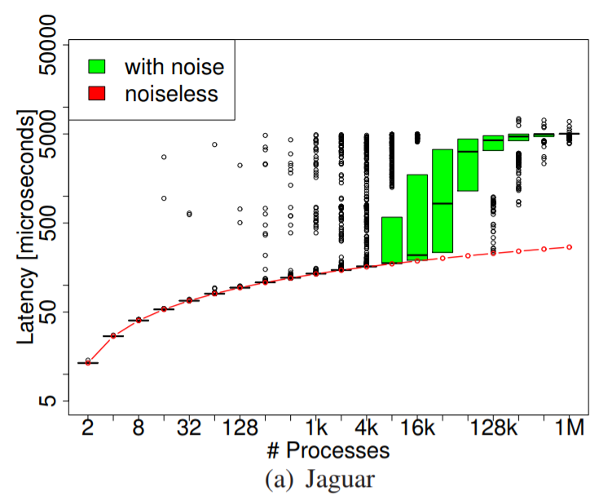
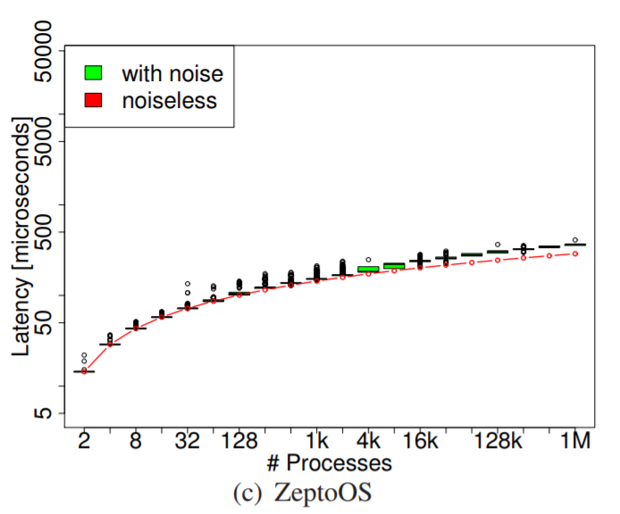
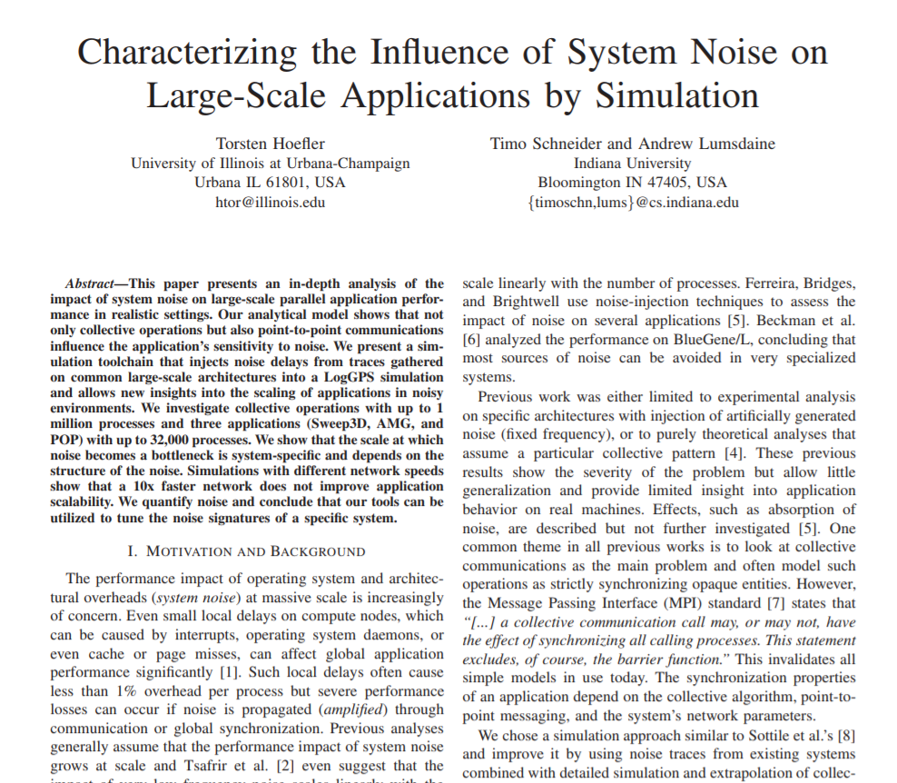
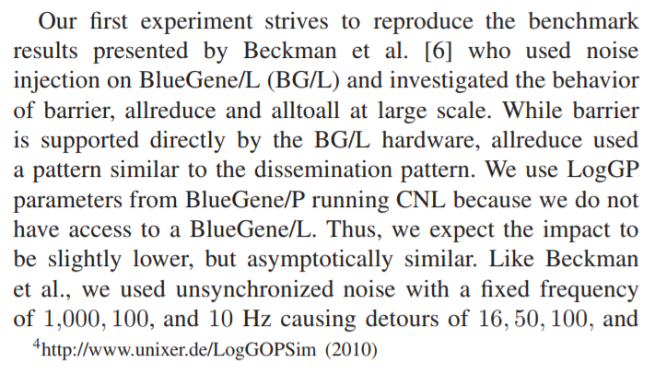
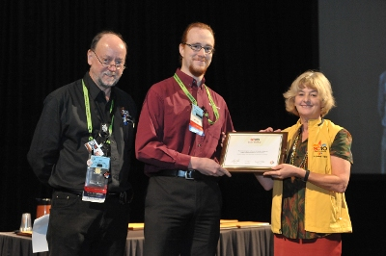
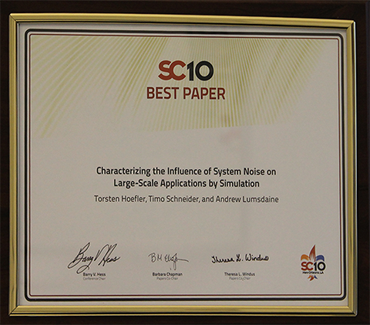
My own replication result
Replicating performance results is possible but rare! Make it the default?
Replicated many folklore results on Jaguar,
results from Ferreira, Bridges, Brightwell
as well as Beckman et al. both two years earlier on
different machines

Slide 12
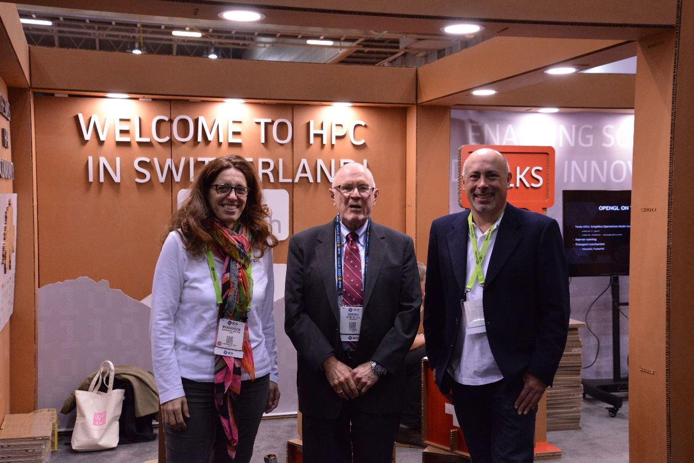

HPC Performance reproducibility – don’t even try?
Nature, May 2016
Reproducibility – get the exact results
Replicability – repeat the effect/insight
Small Quiz
Raise your hand if you believe one can reproduce any Gordon Bell finalist from before 2015!
includes CS/HPC ☺
Interpretability: We call an experiment interpretable if it provides enough information to allow scientists to understand the experiment, draw own conclusions, assess their certainty, and possibly generalize results.

Slide 13

How does Garth measure and report performance?
We are interested in High Performance Computing
We (want to) treat it as a science – reproducing experiments is a major pillar of the scientific method
When measuring performance, important questions are
“How many iterations do I have to run per measurement?”
“How many measurements should I run?”
“Once I have all data, how do I summarize it into a single number?”
“How do I compare the performance of different systems?”
“How do I measure time in a parallel system?”
…
How are they answered in the field today?
Young scientists ask their advisors … who typically answer based on intuition
We (the community) need to establish scientific principles for benchmarking
But do we not already have them – let’s see …
Garth is a young, inexperienced and very smart student!

Slide 14

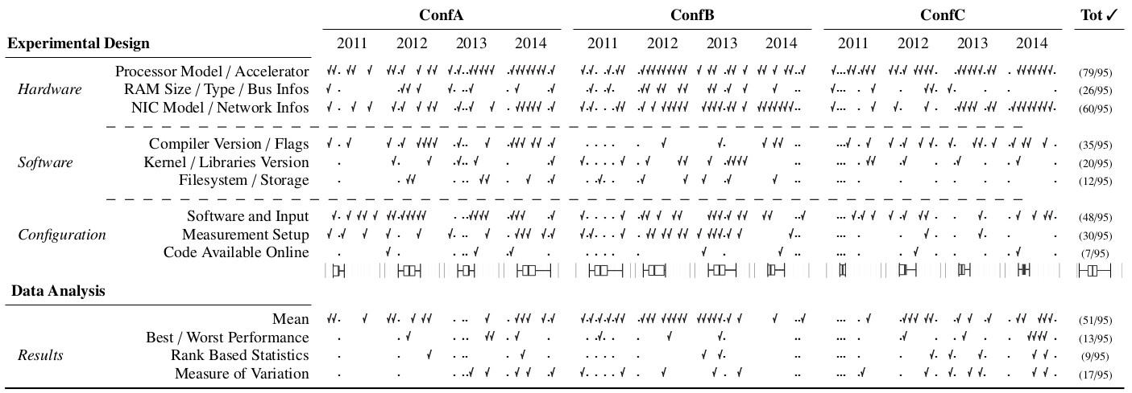
State of the Practice in HPC
Stratified random sample of three top-conferences over four years
HPDC, PPoPP, SC (years: 2011, 2012, 2013, 2014)
10 random papers from each (10-50% of population)
120 total papers, 20% (25) did not report performance (were excluded)
Main results:
Most papers report details about the hardware but fail to describe the software environment.
Important details for reproducibility missing
The average paper’s results are hard to interpret and easy to question
Measurements and data not well explained
No statistically significant evidence for improvement over the years ☹
Our main thesis:
Performance results are often nearly impossible to reproduce! Thus, we need to provide enough information to allow scientists to understand the experiment, draw own conclusions, assess their certainty, and possibly generalize results.
This is especially important for HPC conferences and activities such as the Gordon Bell prize!
Notes:
- Picture of Roberto!!!

Slide 15

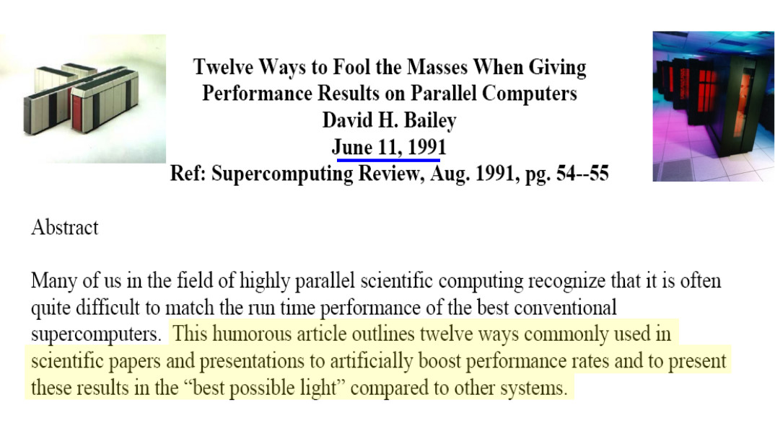
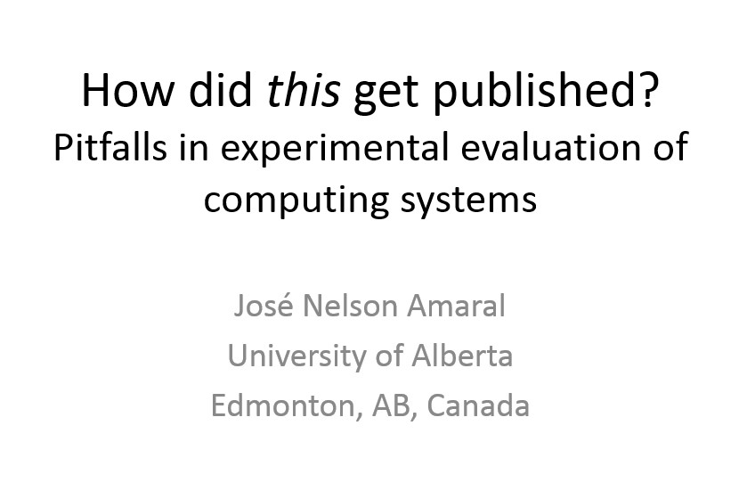
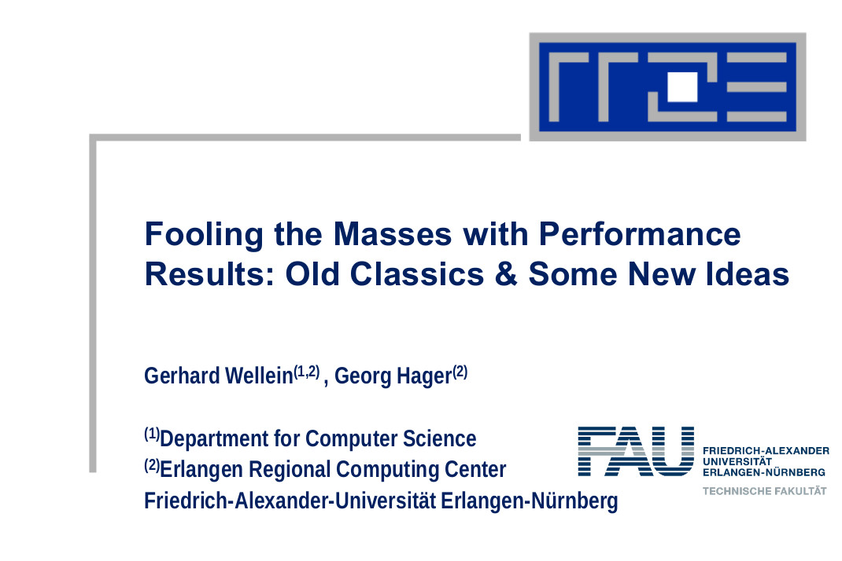

Well, we all know this - but do we really know how to fix it?
1991 – the classic!
2012 – the shocking
2013 – the extension
Yes, this is a garlic press!
Eddie is
Garth’s
advisor
…

Slide 16
This is not new – meet Eddie!
1991 – the classic!
Our constructive approach: provide a set of (12) rules
2012 – the shocking
Attempt to emphasize interpretability of performance experiments
The set is not complete
And probably never will be
Intended to serve as a solid start
Call to the community to extend it
I will illustrate some of the 12 rules now
Using real-world examples
All anonymized!
Garth and Eddie will represent the naive/good scientist
2013 – the extension
Yes, this is a garlic press!
…

Slide 17


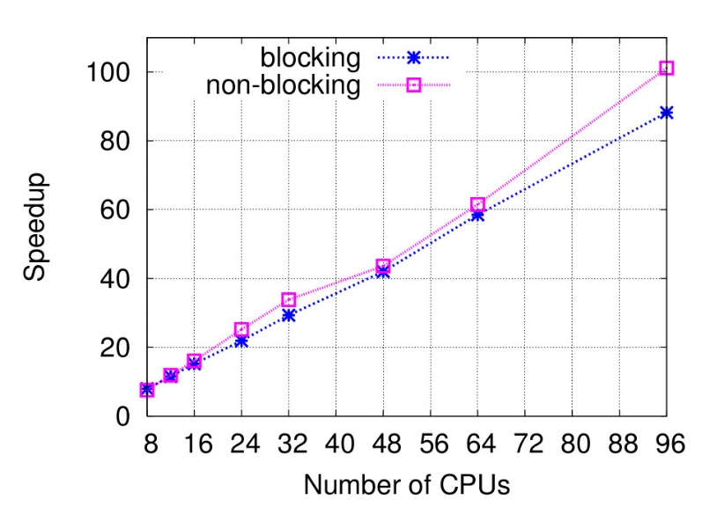

The most common issue: speedup plots
I can’t tell if this is useful at all!
Check out my wonderful Speedup!
Most common and oldest-known issue
First seen 1988 – also included in Bailey’s 12 ways
39 papers reported speedups
15 (38%) did not specify the base-performance ☹
Rediscovered in the “big data” universe
A. Rowstron et al.: Nobody ever got fired for using Hadoop on a cluster, HotCDP 2012
F. McSherry et al.: Scalability! but at what cost?, HotOS 2015
TH, Belli: Scientific Benchmarking of Parallel Computing Systems, IEEE/ACM SC15
Notes:
- Fix Hadoop reference
- Get some data from McSherry’s and Hadoop papers (put lower right)

Slide 18
The most common issue: speedup plots
I can’t tell if this is useful at all!
Check out my wonderful Speedup!
Rule 1: When publishing parallel speedup, report if the base
case is a single parallel process or best serial execution, as well as the absolute execution performance of the base case.
Most common and oldest-known issue
First seen 1988 – also included in Bailey’s 12 ways
39 papers reported speedups
15 (38%) did not specify the base-performance ☹
Rediscovered in the “big data” universe
A. Rowstron et al.: Nobody ever got fired for using Hadoop on a cluster, HotCDP 2012
F. McSherry et al.: Scalability! but at what cost?, HotOS 2015
A simple generalization of this rule implies that one should never report ratios without absolute values.
TH, Belli: Scientific Benchmarking of Parallel Computing Systems, IEEE/ACM SC15
Notes:
- Fix Hadoop reference
- Get some data from McSherry’s and Hadoop papers (put lower right)

Slide 19


The mean parts of means – or how to summarize data
Rule 3: Use the arithmetic mean only for summarizing costs. Use the harmonic mean for summarizing rates.
But GarthCC is 10% faster than ICC on average!
You cannot use the arithmetic mean for ratios!
Rule 4: Avoid summarizing ratios; summarize the costs or rates that the ratios base on instead. Only if these are not available use the geometric mean for summarizing ratios.
+20%
+20%
+20%
-20%
Ah, true, the geometric mean is 8% speedup!
51 papers use means to summarize data, only four (!) specify which mean was used
A single paper correctly specifies the use of the harmonic mean
Two use geometric means, without reason
Similar issues in other communities (PLDI, CGO, LCTES) – see N. Amaral’s report
harmonic mean ≤ geometric mean ≤ arithmetic mean
The geometric mean has no clear interpretation! What was the completion time of the whole workload?
Ugs, well, BT ran much longer than the others. GarthCC is actually 10% slower!
TH, Belli: Scientific Benchmarking of Parallel Computing Systems, IEEE/ACM SC15

Slide 20
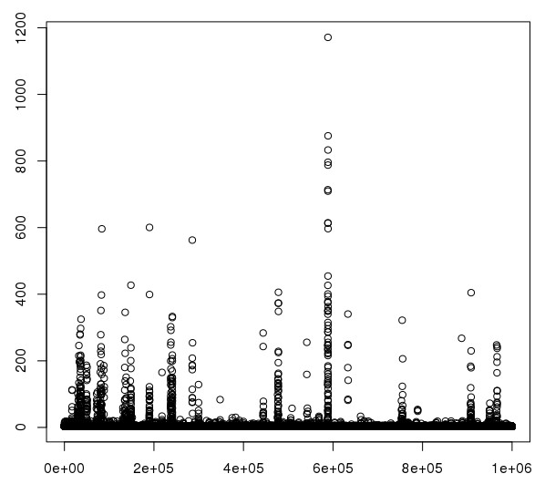
The simplest networking question: ping pong latency!
How did you get to this?
The latency of Piz Dora is 1.77us!
Rule 5: Report if the measurement values are deterministic. For nondeterministic data, report confidence intervals of the measurement.
usec
Most papers report nondeterministic measurement results
Only 15 mention some measure of variance
Only two (!) report confidence intervals
CIs allow us to compute the number of required measurements!
Can be very simple, e.g., single sentence in evaluation:
“We collected measurements until the 99% confidence interval was within 5% of our reported means.”
I averaged 10⁶ tests, it must be right!
Why do you think so? Can I see the data?
sample
TH, Belli: Scientific Benchmarking of Parallel Computing Systems, IEEE/ACM SC15
Notes:
→ Fix cropped plot
x=read.table("dora/iter_1000000/MPI_MP_PingPong_oneWay_size_8_iter_1000000-2015-04-03_19-22.pid-17229.out", header=TRUE)
plot(x[[2]])

Slide 21
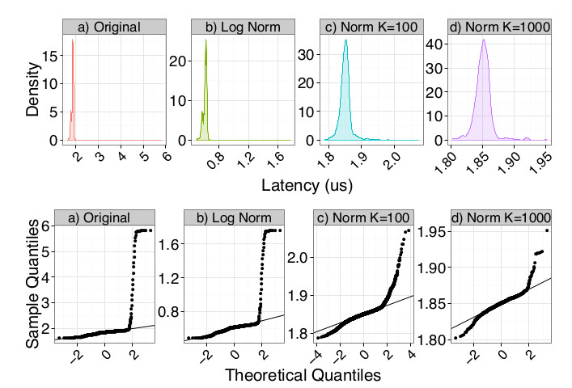
Thou shalt not trust your average textbook!
The confidence interval is 1.765us to 1.775us
Did you assume normality?
Rule 6: Do not assume normality of collected data (e.g., based on the number of samples) without diagnostic checking.
Most events will slow down performance
Heavy right-tailed distributions
The Central Limit Theorem only applies asymptotically
Some papers/textbook mention “30-40 samples”, don’t trust them!
Two papers used CIs around the mean without testing for normality
Ugs, the data is not normal at all! The real CI is actually 1.6us to 1.9us!
Yes, I used the central limit theorem to normalize by summing subsets of size 100!
Can we test for normality?
TH, Belli: Scientific Benchmarking of Parallel Computing Systems, IEEE/ACM SC15

Slide 22
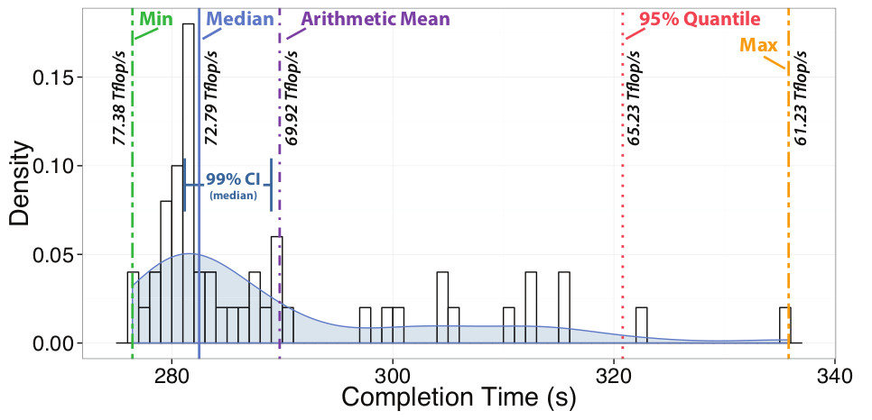
Dealing with non-normal data – nonparametric statistics
Rank-based measures (no assumption about distribution)
Essentially always better than assuming normality
Example: median (50th percentile) vs. mean for HPL
Rather stable statistic for expectation
Other percentiles (usually 25th and 75th) are also useful
TH, Belli: Scientific Benchmarking of Parallel Computing Systems, IEEE/ACM SC15
Notes:
→ remove

Slide 23
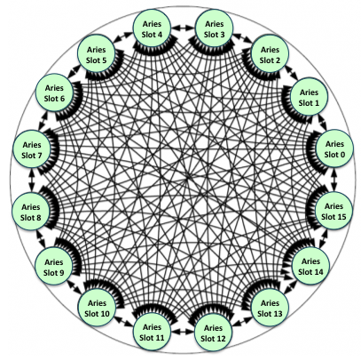
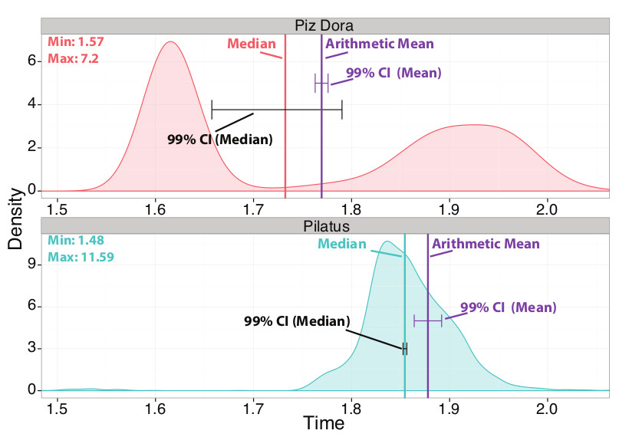

Thou shalt not trust your system!
Look what data I got!
S
D
Image credit: nersc.gov
Clearly, the mean/median are not sufficient!
Try quantile regression!

Slide 24

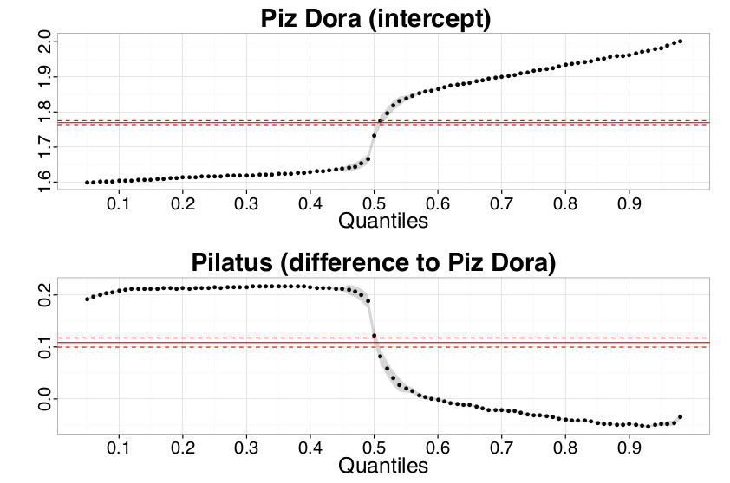
Quantile Regression
Wow, so Pilatus is better for (worst-case) latency-critical workloads even though Dora is expected to be faster
Rule 8: Carefully investigate if measures of central tendency
such as mean or median are useful to report. Some problems,
such as worst-case latency, may require other percentiles.
Check Oliveira et al. “Why you should care about quantile regression”. SIGARCH Computer Architecture News, 2013.
TH, Belli: Scientific Benchmarking of Parallel Computing Systems, IEEE/ACM SC15

Slide 25

How many measurements are needed?
Measurements can be expensive!
Yet necessary to reach certain confidence
How to determine the minimal number of measurements?
Measure until the confidence interval has a certain acceptable width
For example, measure until the 95% CI is within 5% of the mean/median
Can be computed analytically assuming normal data
Compute iteratively for nonparametric statistics
Often heard: “we cannot afford more than a single measurement”
E.g., Gordon Bell runs
Well, then one cannot say anything about the variance
Even 3-4 measurement can provide very tight CI (assuming normality)
Can also exploit repetitive nature of many applications
TH, Belli: Scientific Benchmarking of Parallel Computing Systems, IEEE/ACM SC15
Notes:
→ Fix normality assumption

Slide 26
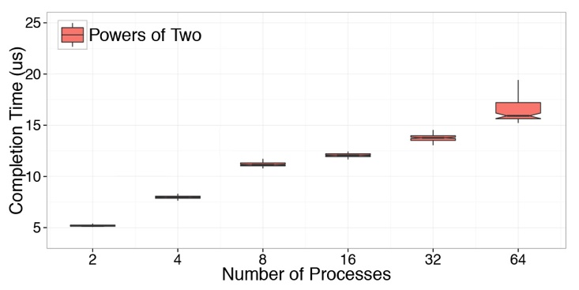
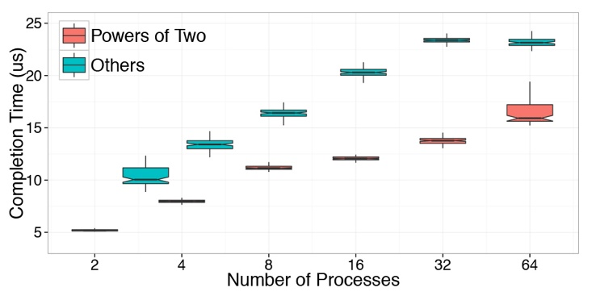
Experimental design
I don’t believe you, try other numbers of processes!
MPI_Reduce behaves much simpler!
Rule 9: Document all varying factors and their levels as well as the complete experimental setup (e.g., software, hardware, techniques) to facilitate reproducibility and provide interpretability.
We recommend factorial design
Consider parameters such as node allocation, process-to-node mapping, network or node contention
If they cannot be controlled easily, use randomization and model them as random variable
This is hard in practice and not easy to capture in rules
TH, Belli: Scientific Benchmarking of Parallel Computing Systems, IEEE/ACM SC15

Slide 27
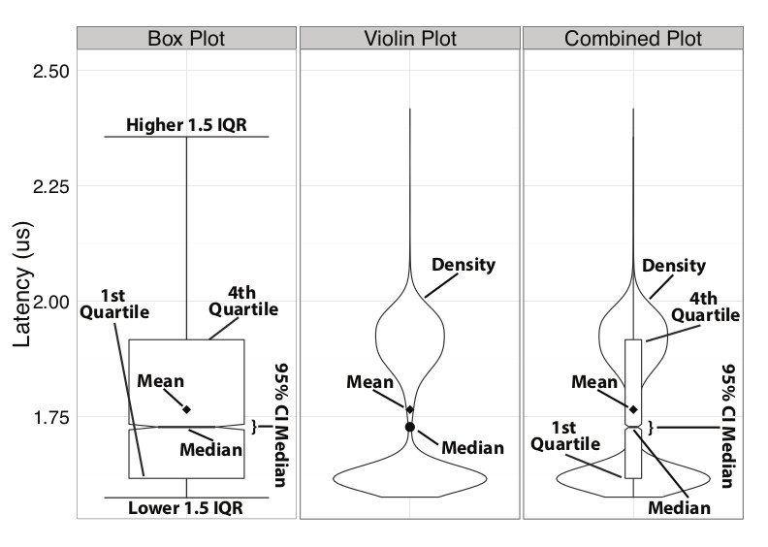

Plot as much information as possible!
My most common request was “show me the data”
Rule 12: Plot as much information as needed to interpret the
experimental results. Only connect measurements by lines if they indicate trends and the interpolation is valid.
This is how I should have presented the Dora results.
TH, Belli: Scientific Benchmarking of Parallel Computing Systems, IEEE/ACM SC15

Slide 28
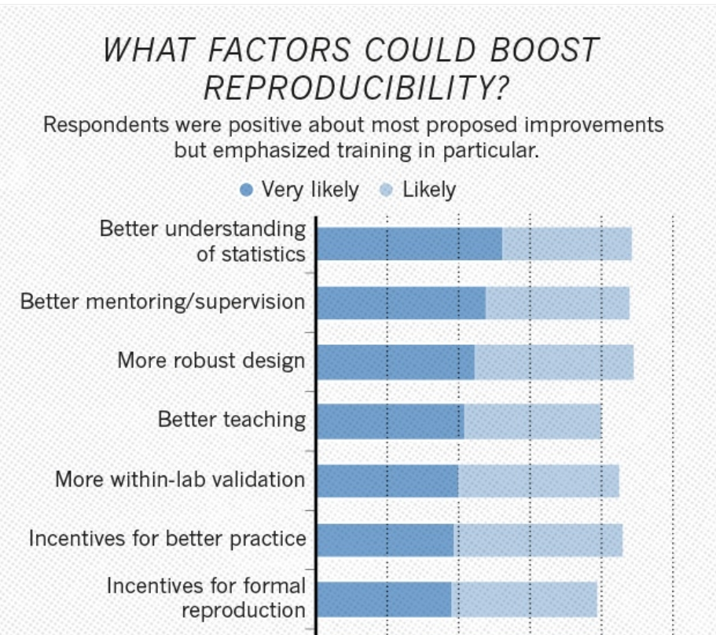
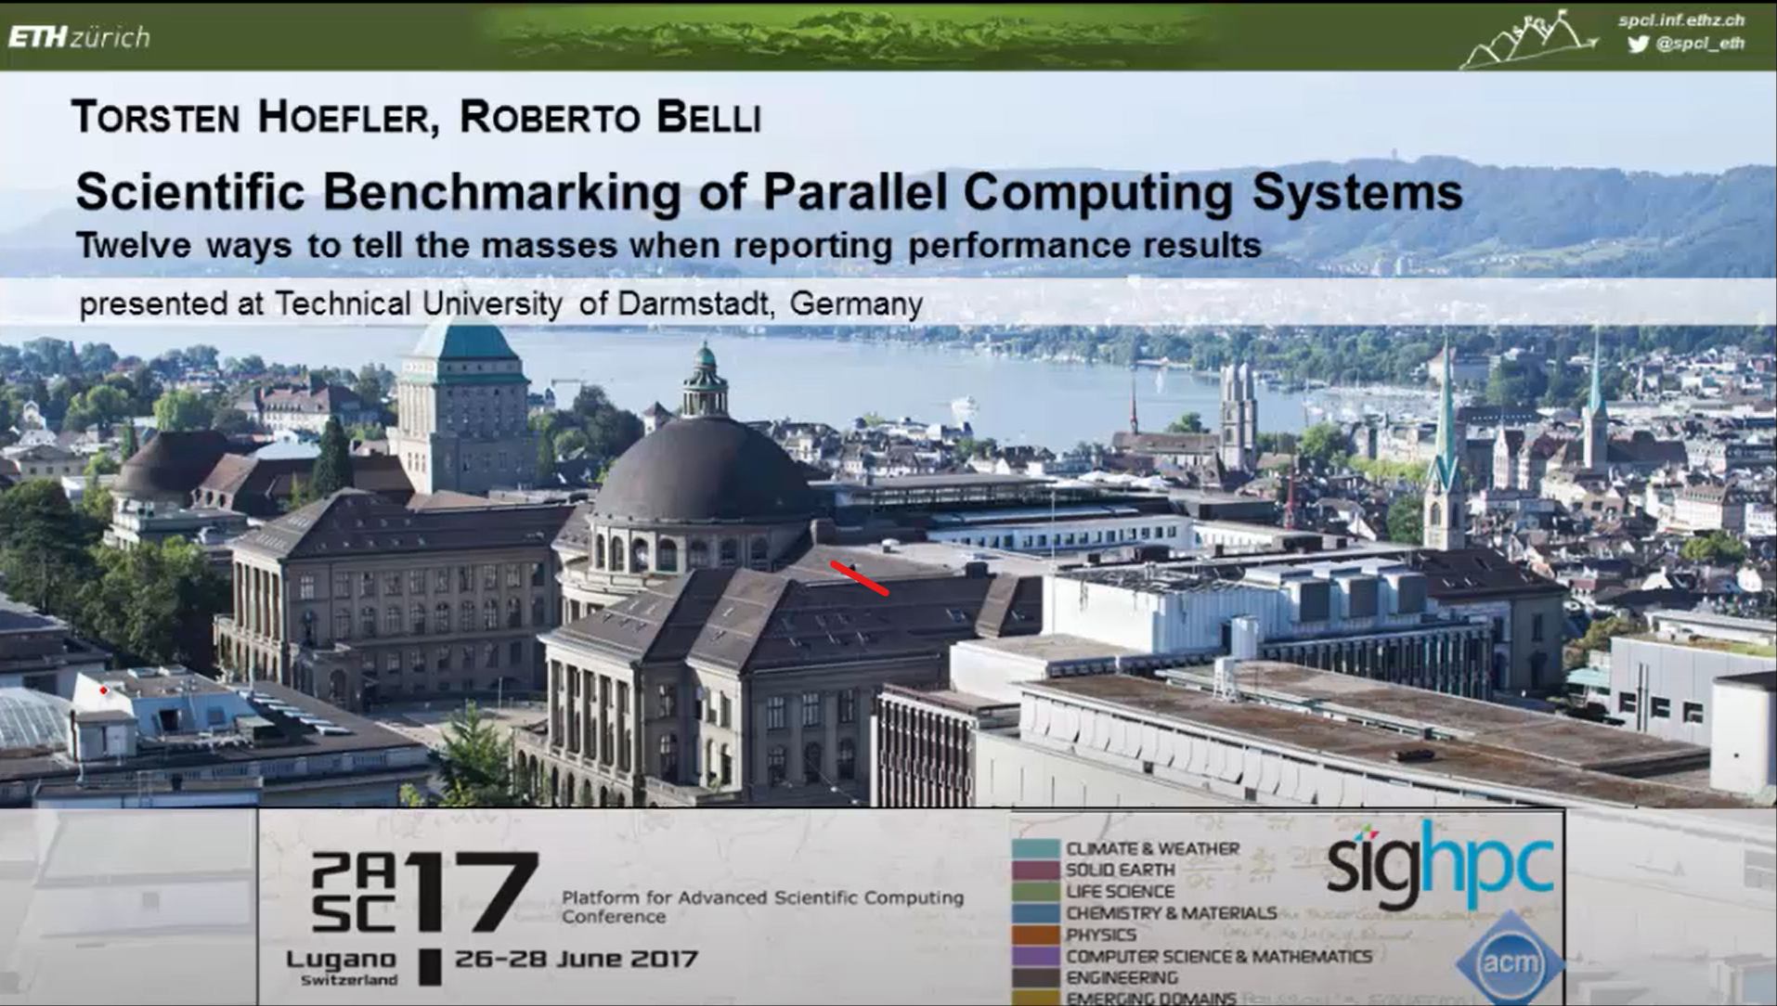

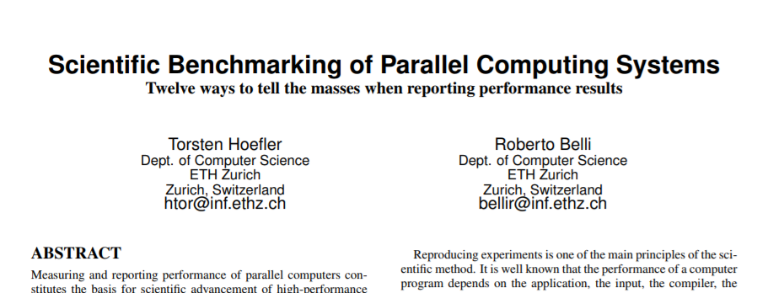
Wrapping up the 12 rules …
Nature, 2016
Attempt to emphasize interpretability of performance experiments
Teach some basic statistics
The set of 12 rules is not complete
And probably never will be
Intended to serve as a solid start
Call to the community to extend it

Slide 29

The Ugly
Recent Advances in Ways to
Fool The Masses
New 2023 Edition – Now
With Statistics

Slide 30

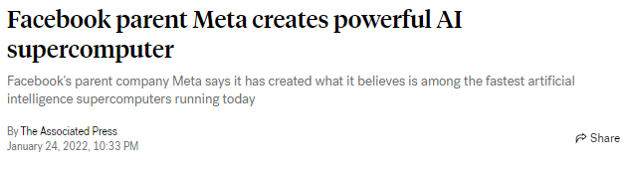
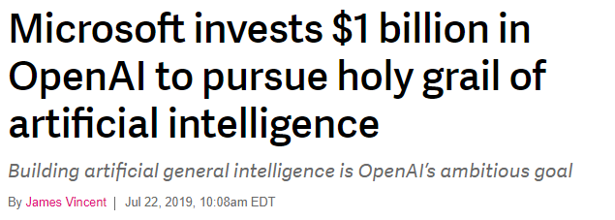

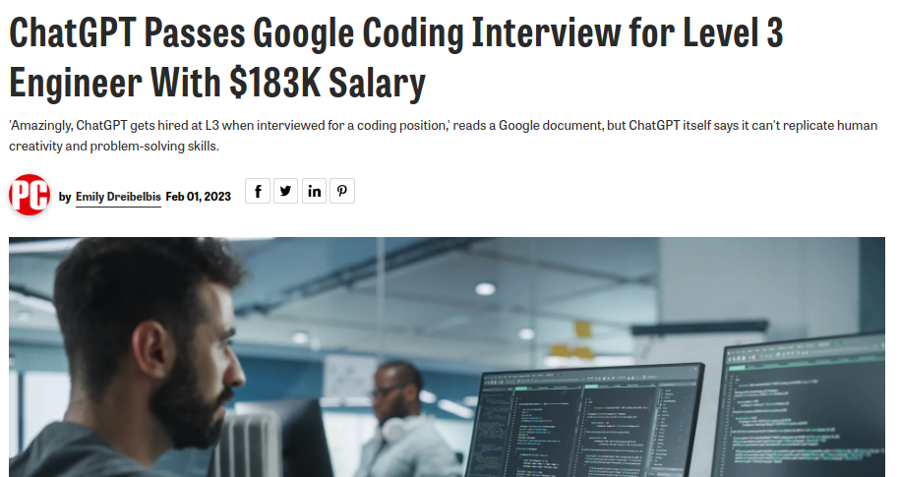

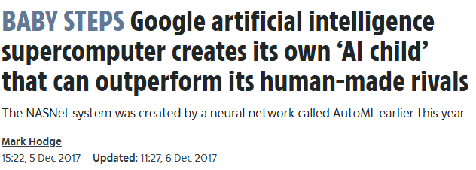





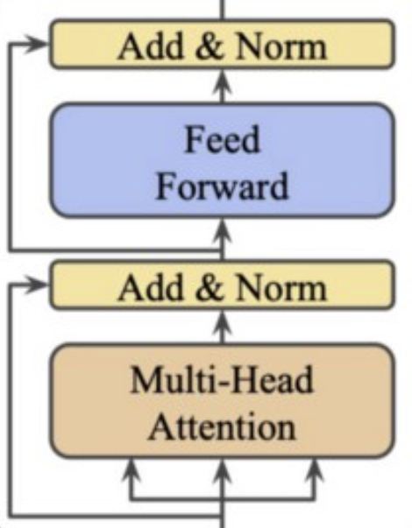
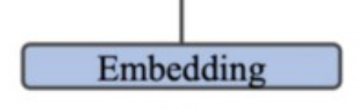
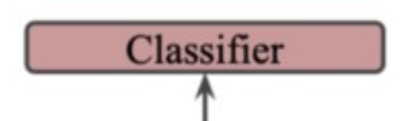
HPC was yesterday – The Brave new ML / AI World
Source: https://medium.com/
Source: https://www.medpagetoday.com/
Deep learning is HPC for Large-Scale Statistics!
Source: https://www.ft.com/
10k GPUs
f(x)
A robot may __ injure a human being or, through inaction, allow a human being to come to harm.
not
0.74
not
1.00
sometimes
0.28
sometimes
0.00
…
always
0.07
always
0.00
never
0.04
never
0.00
and
0.33
and
0.00
boat
0.02
boat
0.00
house
0.02
house
0.00
layer-wise weight update
GPT-3: 500 billion tokens
ImageNet (22k): A few TB
Soon: the whole internet!
GPT-3: 96 (complex) layers
175 bn parameters (700 GiB in fp32)
2048-token “sentences”
GPT-3: 30-50k dictionaries
takes weeks to train
T. Ben-Nun, TH: Demystifying parallel and distributed deep learning: An in-depth concurrency analysis, ACM Computing Surveys (CSUR), 2019

Slide 31
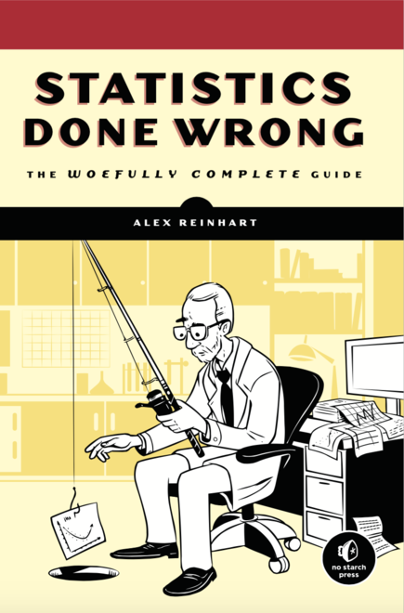

“Statistical performance” vs. “hardware performance”
Tradeoffs between those two
Very unusual for HPC people – we always operated in double precision
Mostly out of fear of rounding issues
Deep learning shows how little accuracy one can get away with
Well, examples are drawn randomly from some distribution we don’t know …
Usually, noise is quite high …
So the computation doesn’t need to be higher precision than that noise
Pretty obvious! In fact, it’s similar in scientific computing but in tighter bounds and not as well known
But we HPC folks like flop/s! Or maybe now just ops or even aiops? Whatever, fast compute!
A humorous guide to floptimization
Twelve rules to help present your (not so great?) results in a much better light
2-3 bits per weight/parameter
TH: “Benchmarking Data Science: 12 Ways to Lie With Statistics and Performance on Parallel Computers”, IEEE Computer, Aug. 2022
Notes:
- Add image of new paper

Slide 32


#1 Scale computations at all cost; #2 Trade convergence for performance
Learning community’s “self-correction”
(Y. LeCun)
HPC picking up!
Scale minibatches for data parallelism
May kill / reduce convergence
Run many ensembles with questionable benefits
Some very popular examples, unfortunately!
Asynchronous runs much faster!
Asynchronous SGD
Asynchronous pipelining
Asynchronous operators
No communication – no overhead!
Also: no communication – low convergence!
Surprisingly many (still) do this
Scalability without a good baseline?
(D. Bailey)
TH: “Benchmarking Data Science: 12 Ways to Lie With Statistics and Performance on Parallel Computers”, IEEE Computer, Aug. 2022

Slide 33

#3 Do not consider generalization accuracy
Bigger models achieve higher performance!
Iterations are sequential – sequential = bad
Seen in LLM training!
There it actually seems to work
Pannell et al., 2022
TH: “Benchmarking Data Science: 12 Ways to Lie With Statistics and Performance on Parallel Computers”, IEEE Computer, Aug. 2022

Slide 34

#4 Do not report hyperparameter tuning cost
flop/s!
Report the best run – SGD is a bit fragile, so don’t worry
At the end, the minutes for the final run matter most!
tech-quantum.com
TH: “Benchmarking Data Science: 12 Ways to Lie With Statistics and Performance on Parallel Computers”, IEEE Computer, Aug. 2022

Slide 35



#8 Compare outdated/general purpose HW to specialized HW
NVIDIA P100 in 2023!?
Even though the older machines would win the beauty contest!
vs.
TH: “Benchmarking Data Science: 12 Ways to Lie With Statistics and Performance on Parallel Computers”, IEEE Computer, Aug. 2022

Slide 36


#9 Don’t worry about inference costs
GPT-3 training is estimated to have cost at least $4.6M [1]
Today [06/23] GPT-4 inference costs $6e-5/output token
Assuming 50% profit margin
Break-even after 153.3 bn tokens
Let’s say 200 output tokens per ChatGPT query
break even after 766.7 M queries
Assume 10M queries / day
Inference cost dominates after just 77 days!
So obviously we prefer smaller models!
Yet, they need more expensive training!
Or expensive compression
Distillation, Quantization, Sparsification etc.
Needs 300 bn tokens more to train to same accuracy!
[1] https://lambdalabs.com/blog/demystifying-gpt-3
[2] https://openai.com/pricing
Brown et al.: Language Models are Few-Shot Learners
TH: “Benchmarking Data Science: 12 Ways to Lie With Statistics and Performance on Parallel Computers”, IEEE Computer, Aug. 2022

Slide 37



#10 Do not consider reading the data
Example: ResNet-50 3.8 Gflop inference, $≈$3x for training
ImageNet is 150 GiB for $≈$1.3M images → average size 115 kiB, range: 508B - 15MiB
MLPerf v2.1 on one H100 - 81k samples/s → 9.3 GiB/s random access → ~50 SSDs / GPU
Likely more for problems from scientific computing!
Training on thousands of GPUs may need to manage 10,000s of SSDs
TH: “Benchmarking Data Science: 12 Ways to Lie With Statistics and Performance on Parallel Computers”, IEEE Computer, Aug. 2022

Slide 38


#11 Train on unreasonably large examples
The pinnacle of floptimization! Very hard to catch!
But Dr. Catlock Holmes below can catch it.
vs.
Low-resolution cat (244x244 – 1 Gflop/example)
High-resolution cat (8kx8k – 1 Tflop/example)
TH: “Benchmarking Data Science: 12 Ways to Lie With Statistics and Performance on Parallel Computers”, IEEE Computer, Aug. 2022

Slide 39

#12 Choose your comparison points well
Compare either time to solution or accuracy if both together don’t look strong!
There used to be conventions but let’s redefine them.
TH: “Benchmarking Data Science: 12 Ways to Lie With Statistics and Performance on Parallel Computers”, IEEE Computer, Aug. 2022

Slide 40













Cover feature “Research Reproducibility” in IEEE Computer - All 12 Rules
Continue discussion on twitter https://twitter.com/search?q=12ways%20%2B%20acmrep
40

Slide 41





Key Points and Conclusions
More of SPCL’s research:
youtube.com/@spcl
150+ Talks
twitter.com/spcl_eth
1.2K+ Followers
github.com/spcl
2K+ Stars
… or spcl.ethz.ch
Performance may not be reproducible
Interpretability fosters scientific progress
Enables to build on results
Sound statistics is the biggest gap today
We need to foster interpretability
Teach young students
Maybe even enforce in TPCs
See the 12 rules / 12 ways as a start
Want to join our efforts? We’re looking for excellent
Postdocs, PhD students, and Visitors.
Talk to me!

Slide 43

Conclusions and call for action
Performance may not be reproducible
At least not for many (important) results
Interpretability fosters scientific progress
Enables to build on results
Sounds statistics is the biggest gap today
We need to foster interpretability
Do it ourselves (this is not easy)
Teach young students
Maybe even enforce in TPCs
See the 12 rules as a start
Need to be extended (or concretized)
Much is implemented in LibSciBench [1]
No vegetables were harmed for creating these slides!
Acknowledgments
ETH’s mathematics department (home of R)
Hans Rudolf Künsch, Martin Maechler, and Robert Gantner
Comments on early drafts
David H. Bailey, William T. Kramer, Matthias Hauswirth, Timothy Roscoe, Gustavo Alonso, Georg Hager, Jesper Träff, and Sascha Hunold
Help with HPL run
Gilles Fourestier (CSCS) and Massimiliano Fatica (NVIDIA)
[1]: http://spcl.inf.ethz.ch/Research/Performance/LibLSB/.

Slide 44

Garth’s new compiler optimization
Check out my new compiler!
How did it perform for FT and BT?
Rule 2: Specify the reason for only reporting subsets of standard benchmarks or applications or not using all system resources.
Well, GarthCC segfaulted for FT and was 20% slower for BT.
This implies: Show results even if your code/approach stops scaling!
TH, Belli: Scientific Benchmarking of Parallel Computing Systems, IEEE/ACM SC15

Slide 45

Time in parallel systems
That’s nonsense!
My simple broadcast takes only one latency!
…
But I measured it so it must be true!
Measure each operation separately!
t = -MPI_Wtime();
for(i=0; i<1000; i++) {
MPI_Bcast(…);
}
t += MPI_Wtime();
t /= 1000;
Bcast 1
Bcast 3
Bcast 5
end 1
end 3
end 5
Bcast 2
Bcast 4
end 2
end 4

Slide 46

Summarizing times in parallel systems!
Come on, show me the data!
My new reduce takes only 30us on 64 ranks.
Rule 10: For parallel time measurements, report all measurement, (optional) synchronization, and summarization techniques.
Measure events separately
Use high-precision timers
Synchronize processes
Summarize across processes:
Min/max (unstable), average, median – depends on use-case
TH, Belli: Scientific Benchmarking of Parallel Computing Systems, IEEE/ACM SC15

Slide 47


Give times a meaning!
I have no clue.
I compute 10¹⁰ digits of Pi in 2ms on Dora!
Rule 11: If possible, show upper performance bounds to facilitate interpretability of the measured results.
Model computer system as k-dimensional space
Each dimension represents a capability
Floating point, Integer, memory bandwidth, cache bandwidth, etc.
Features are typical rates
Determine maximum rate for each dimension
E.g., from documentation or benchmarks
Can be used to proof optimality of implementation
If the requirements of the bottleneck dimension are minimal
Can you provide?
Ideal speedup
Amdahl’s speedup
Parallel overheads
Ok: The code runs 17ms on a single core, 0.2ms are initialization and it has one reduction!
TH, Belli: Scientific Benchmarking of Parallel Computing Systems, IEEE/ACM SC15

Slide 48

How to not benchmark machine/deep learning workloads
“Twelve ways to fool the masses when reporting performance of deep learning workloads”
(my humorous guide to floptimize deep learning, blog post Nov. 2018)
https://htor.inf.ethz.ch/blog/index.php/2018/11/08/twelve-ways-to-fool-the-masses-when-reporting-performance-of-deep-learning-workloads/

Slide 49


5) Show only kernels/subsets when scaling!
Run layers or communication kernels in isolation
Avoids issues with accuracy completely ☺
Doesn’t that look a bit like GoogLeNet?
vs.

Slide 50

Comparing nondeterministic measurements
I saw variance using GarthCC as well!
Show me the data!
Rule 7: Compare nondeterministic data in a statistically sound
way, e.g., using non-overlapping confidence intervals or ANOVA.
Rule 7: Compare nondeterministic data in a statistically sound
way, e.g., using non-overlapping confidence intervals or ANOVA.
17.5
15
12.5
None of the investigated papers used statistically sound comparisons
The “effect size” can even be a stronger metric
20%
10
95% CI
Execution Time
7.5
Retract the paper! You have not shown anything!
5.0
2.5
TH, Belli: Scientific Benchmarking of Parallel Computing Systems, IEEE/ACM SC15
ICC
GarthCC

Slide 51


6) Do not consider I/O!
Reading the data? Nah, make sure it’s staged in memory when the benchmark starts!

Slide 52


7) Report highest ops numbers (whatever that means)!
Yes, we’re talking ops today, 64-bit flops was so yesterday!
If we don’t achieve a target fast enough, let’s redefine it!
And never talk about how many more of those ops one needs to find a solution, it’s all about the rate, op/s!
Actually, my laptop achieves an “exaop”:
each of the 3e9 transistors switching a binary digit each at 2.4e9 Hz
vs.

Slide 53


8) Show performance when enabling option set A and show accuracy when enabling option set B!
Pretty cool idea isn’t it? Hyperparameters sometimes conflict
So always tune the to show the best result, whatever the result shall be!

Slide 54


10) Run training just for the right time!
Train for fixed wall-time when scaling processors
so when you use twice as many processors you get twice as many flop/s!
But who cares about application speedup?

Slide 55

11) Minibatch sizing for fun and profit – weak vs. strong scaling.
All DL is strong scaling – limited model and limited data
So just redefine the terms relative to minibatches:
Weak scaling keeps MB size per process constant – overall grows (less iterations per epoch, duh!)
Strong scaling keeps overall MB size constant (better but harder)
Microbatching is not a problem!

Slide 56

Summary
More of SPCL’s research:
youtube.com/@spcl
210+ Talks
twitter.com/spcl_eth
1.6K+ Followers
github.com/spcl
5.2K+ Stars
… or spcl.ethz.ch
We are looking
for Academic Visitors, Postdocs, and PhD students!
http://spcl.ethz.ch/Jobs/
http://spcl.ethz.ch/Visit/
Notes:
show key slides

